Slide 1
Sound
What are the behaviors and characteristics of sound?

Slide 2
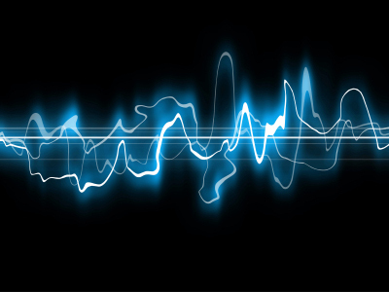
The Nature of Sound
I can describe the properties of sound
I can tell what affects the properties of sound

Slide 3
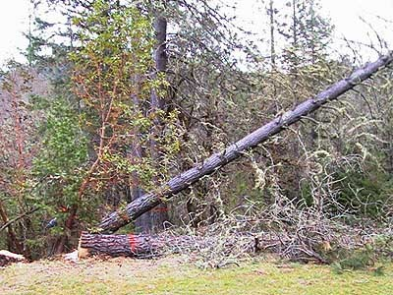
What is Sound?
If a tree falls in a forest and no one hears it, does the tree make a sound?
How is sound defined?
If sound requires someone to hear it, then no, the tree makes no sound.
Because sound is a disturbance that travels through a medium, a scientist will say that the tree makes a sound.

Slide 4
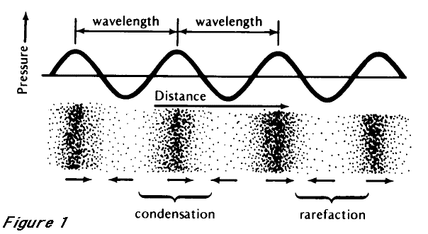
What is sound?
A disturbance that travels through a medium as a wave.
The wave causes particles to vibrate back and forth.

Slide 5
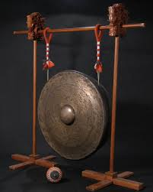
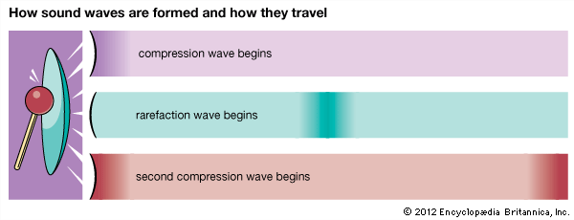
How does sound form?
A sound wave begins with vibration
The vibrations disturb nearby particles
When it moves to the right, particles compress
When it moves left, the particles spread out

Slide 6
How does sound travel?
Like other waves, sound waves travel in a medium
A common medium is air, but can be liquids and solids too
Each particle of the medium vibrates as the disturbance passes
When the disturbance reaches your ear you hear the sound

Slide 7
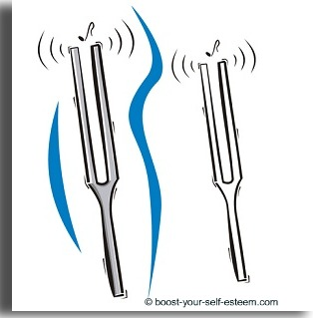
Vibration
When something moves back and forth, up and down, or side to side we say it vibrates.

Slide 8
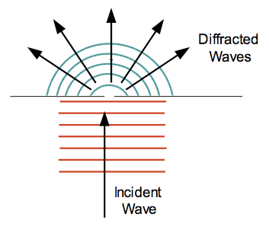
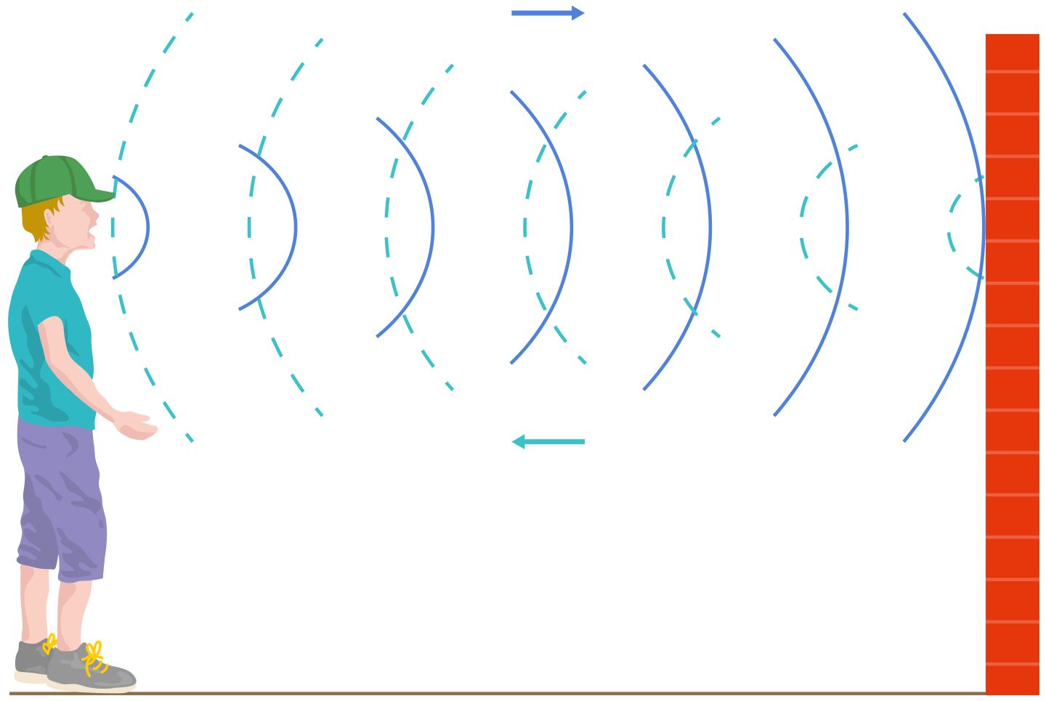
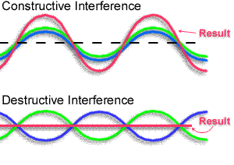
Interactions of Sound Waves
Reflection: sound waves reflect when they hit a surface, this is an echo.
Diffraction: When sound waves move through an opening they can bend.
Interference: Occurs when sound waves meet and interact with each other.

Slide 9
The Speed of Sound
The speed of sound depends on the elasticity, density, and temperature of the medium it travels through.
Speed of Sound
Medium | Speed (m/s)
Gasses
Air (0°C) | 331
Air (20°C) | 343
Liquids (30°C)
Fresh Water | 1,509
Salt Water | 1,546
Solids (25°C)
Lead | 1,210
Cast Iron | 4,480
Aluminum | 5,000
Glass | 5,170

Slide 10
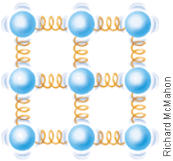
Elasticity
The ability of a material to bounce back after being disturbed.
The more elastic a medium, the faster sound will travel.
Particles in a solid bounce back quickly
Most liquids are not very elastic
Gasses are usually the least elastic

Slide 11
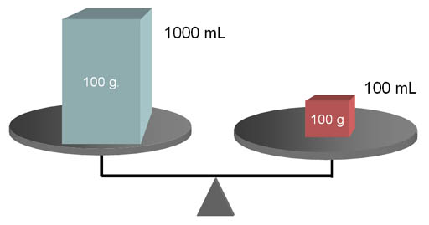
Density
A ratio that compares the mass of an object to its volume.
In materials in the same state of matter (solid, liquid, and gas) sound moves slower in the more dense ones.

Slide 12
Temperature
The measure of the average kinetic energy in the particles of an object.
In a given medium sound travels faster when it is at a higher temperature
In the same medium sound will travel slower when it is at a lower temperature

Slide 13
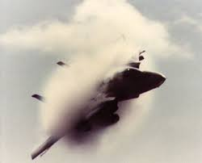
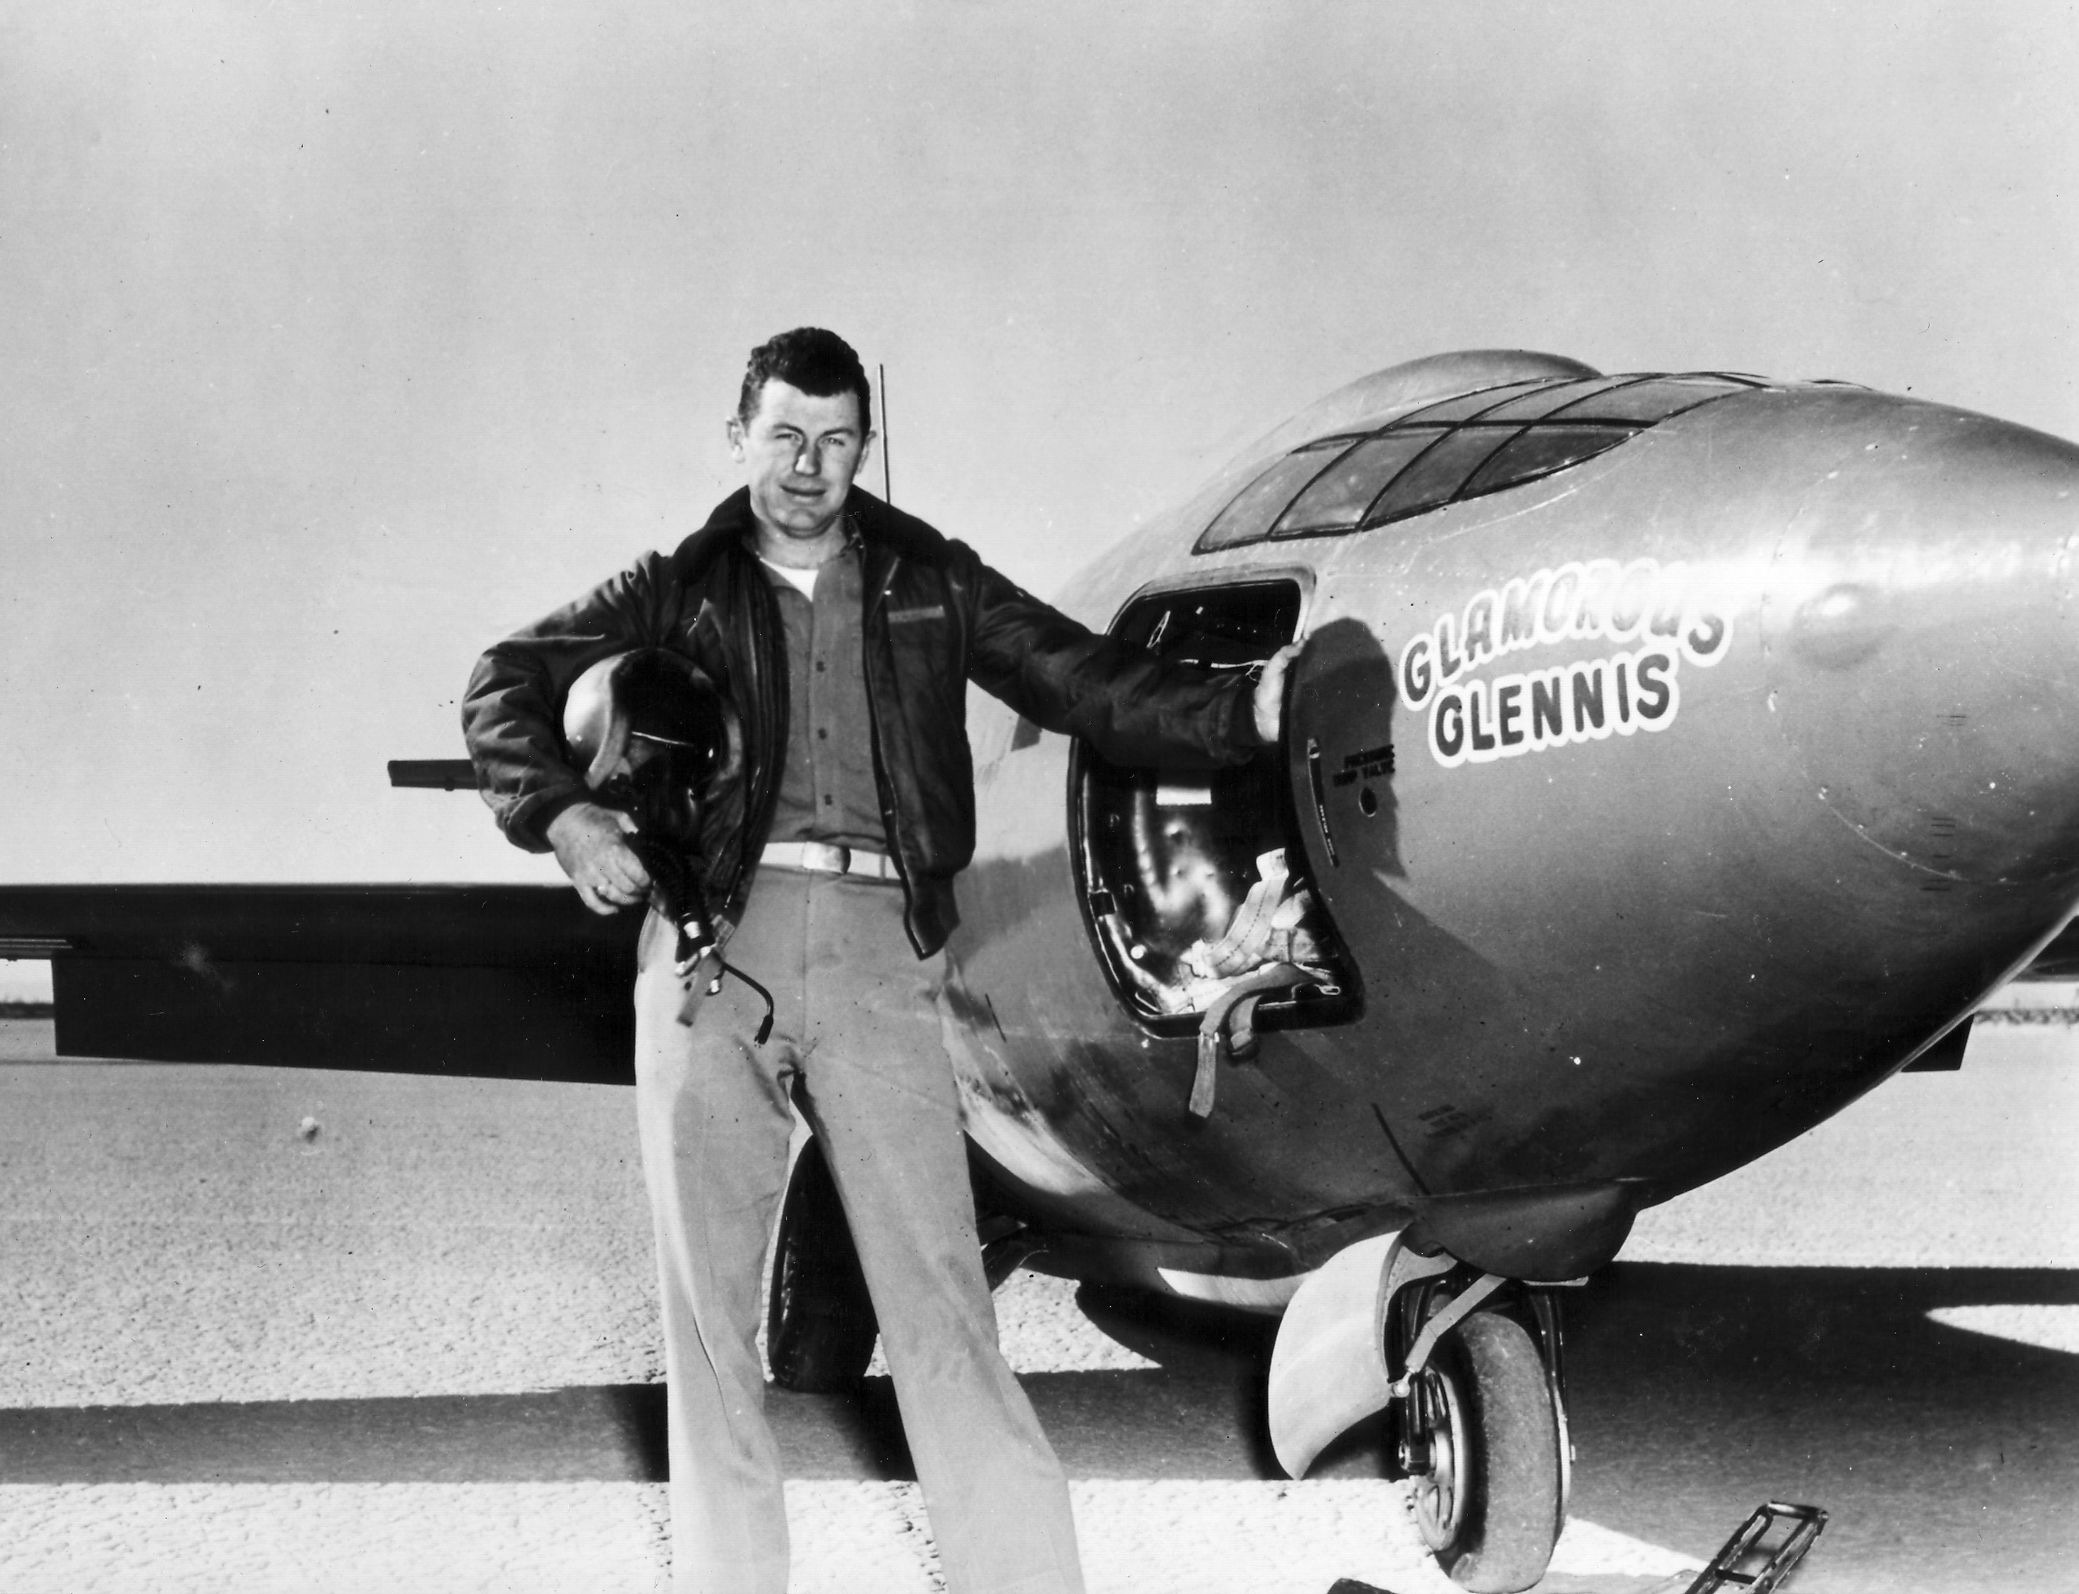
Going Faster than Sound
On October 14, 1947 Chuck Yeager flew faster than sound.
Why did he try in the air and not the water?
Why did he choose to fly at 12,000 meters?
What properties of sound affected his flight?

Slide 14
The Properties of Sound
What factors affect the loudness of a sound?
What does the pitch of a sound depend on?
What causes the Doppler effect?

Slide 15
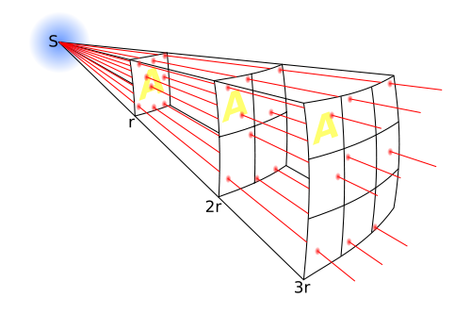
Loudness
Describes your perception of the energy of a sound.
Energy of the source
Distance from the source
Intensity: The amount of energy per second carried through a unit area by a wave.

Slide 16
Measuring Loudness
Loudness of a sound is measured using a unit called a decibel (dB).
Sounds you can barely hear are 0 dB
Sounds louder than 100 dB can cause damage to your ears
Measuring Loudness
Sound | Loudness (dB)
Rustling leaves | 10
Whisper | 15-20
Very soft music | 20-30
Normal conversation | 40-50
Heavy street traffic | 60-70
Loud music | 90-100
Rock concert | 110-120
Jackhammer | 120
Jet plane takeoff | 120-160

Slide 17
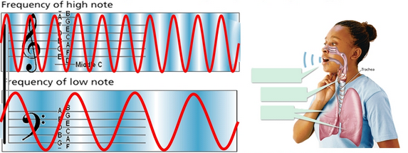
Pitch
Pitch: A description of how high or low the sound seems to a person.
The pitch of a sound depends on the frequency of the wave.
Frequency is measured in hertz (Hz)
50 Hz means 50 vibrations per second

Slide 18
Human Hearing and Voice
Most people can hear sounds with frequencies between 20 Hz and 20,000 Hz.
Sound waves with frequencies above that range are called ultrasound.
Sound waves with frequencies below that range are called infrasound.
Humans can change the pitch of their voice using the voice box, or larynx.

Slide 19
The Doppler Effect
A change in sound frequency caused by motion of the sound source, motion of the listener, or both.

Slide 20
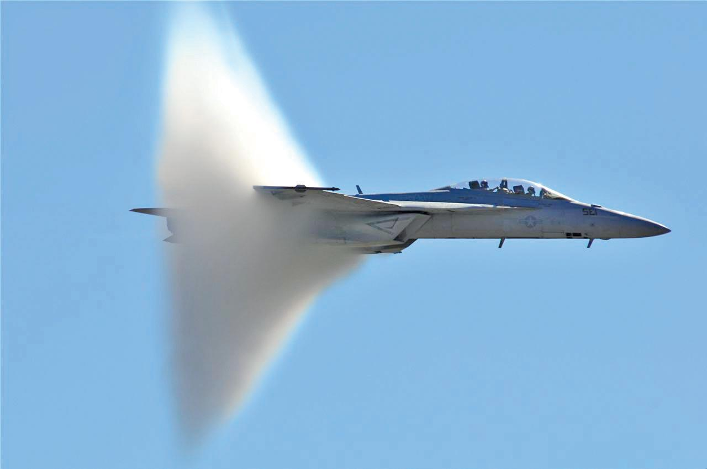
Doppler Effect and Shock Waves (Sonic Boom)

Slide 21
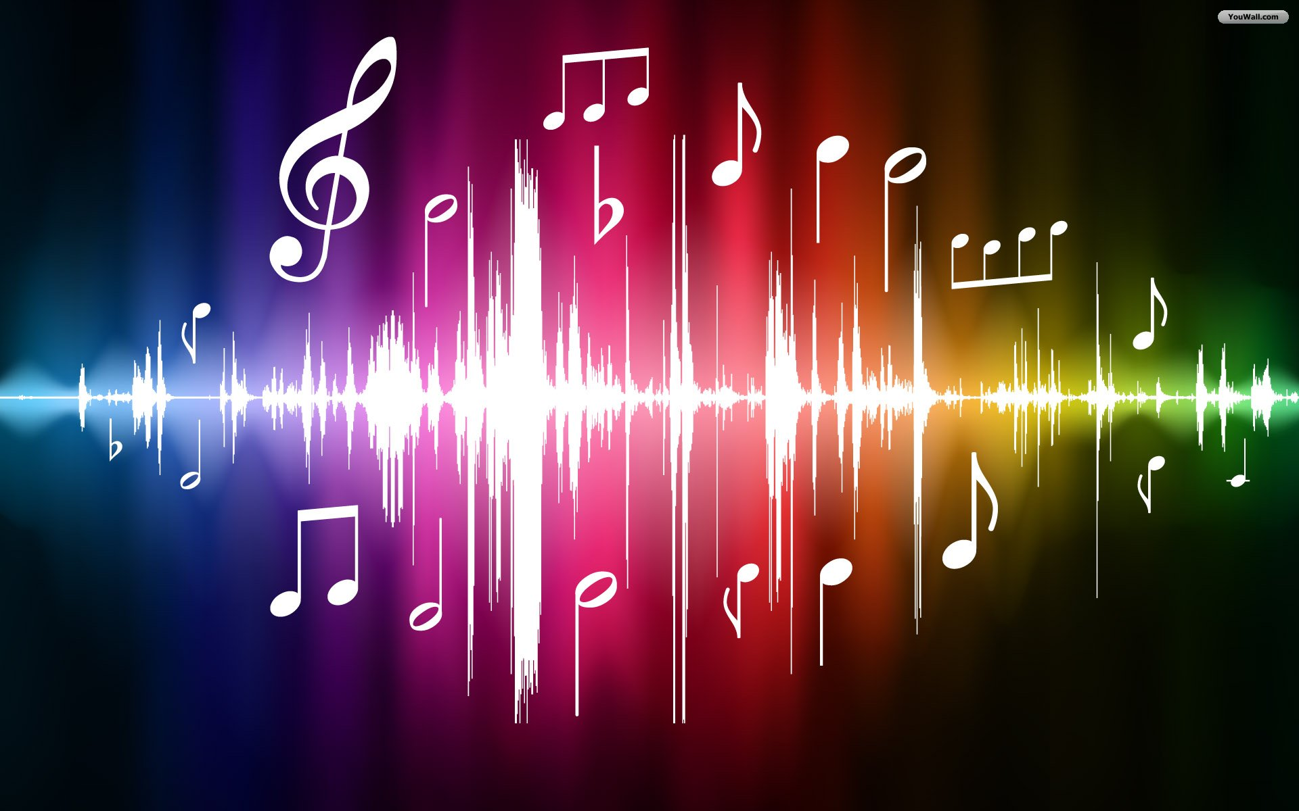
Music
What makes a sound pleasant or unpleasant?
Music is a set of notes that combine into a pleasing pattern.
Does everyone describe music the same?

Slide 22
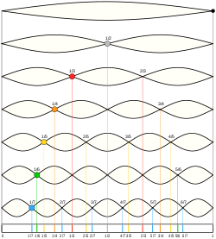
Tones
Fundamental tones: the lowest natural frequency of an object.
Overtones: the object’s higher natural frequencies.
Different instruments vibrate at different natural frequencies. This is the reason that each type of instrument has a unique sound.

Slide 23
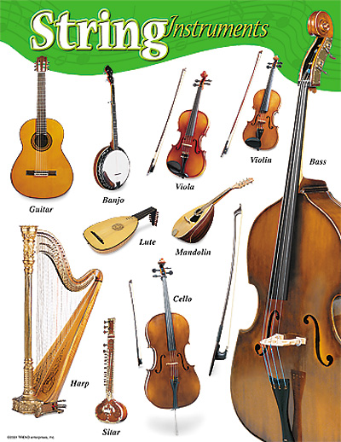
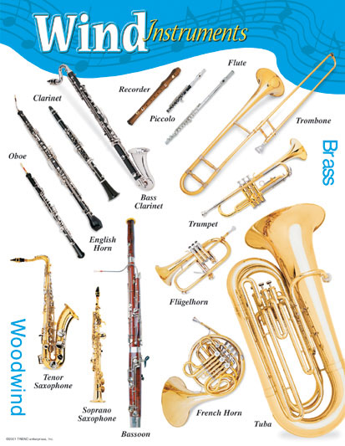
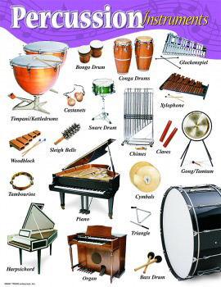
Groups of Instruments
Stringed
Wind
Percussion

Slide 24
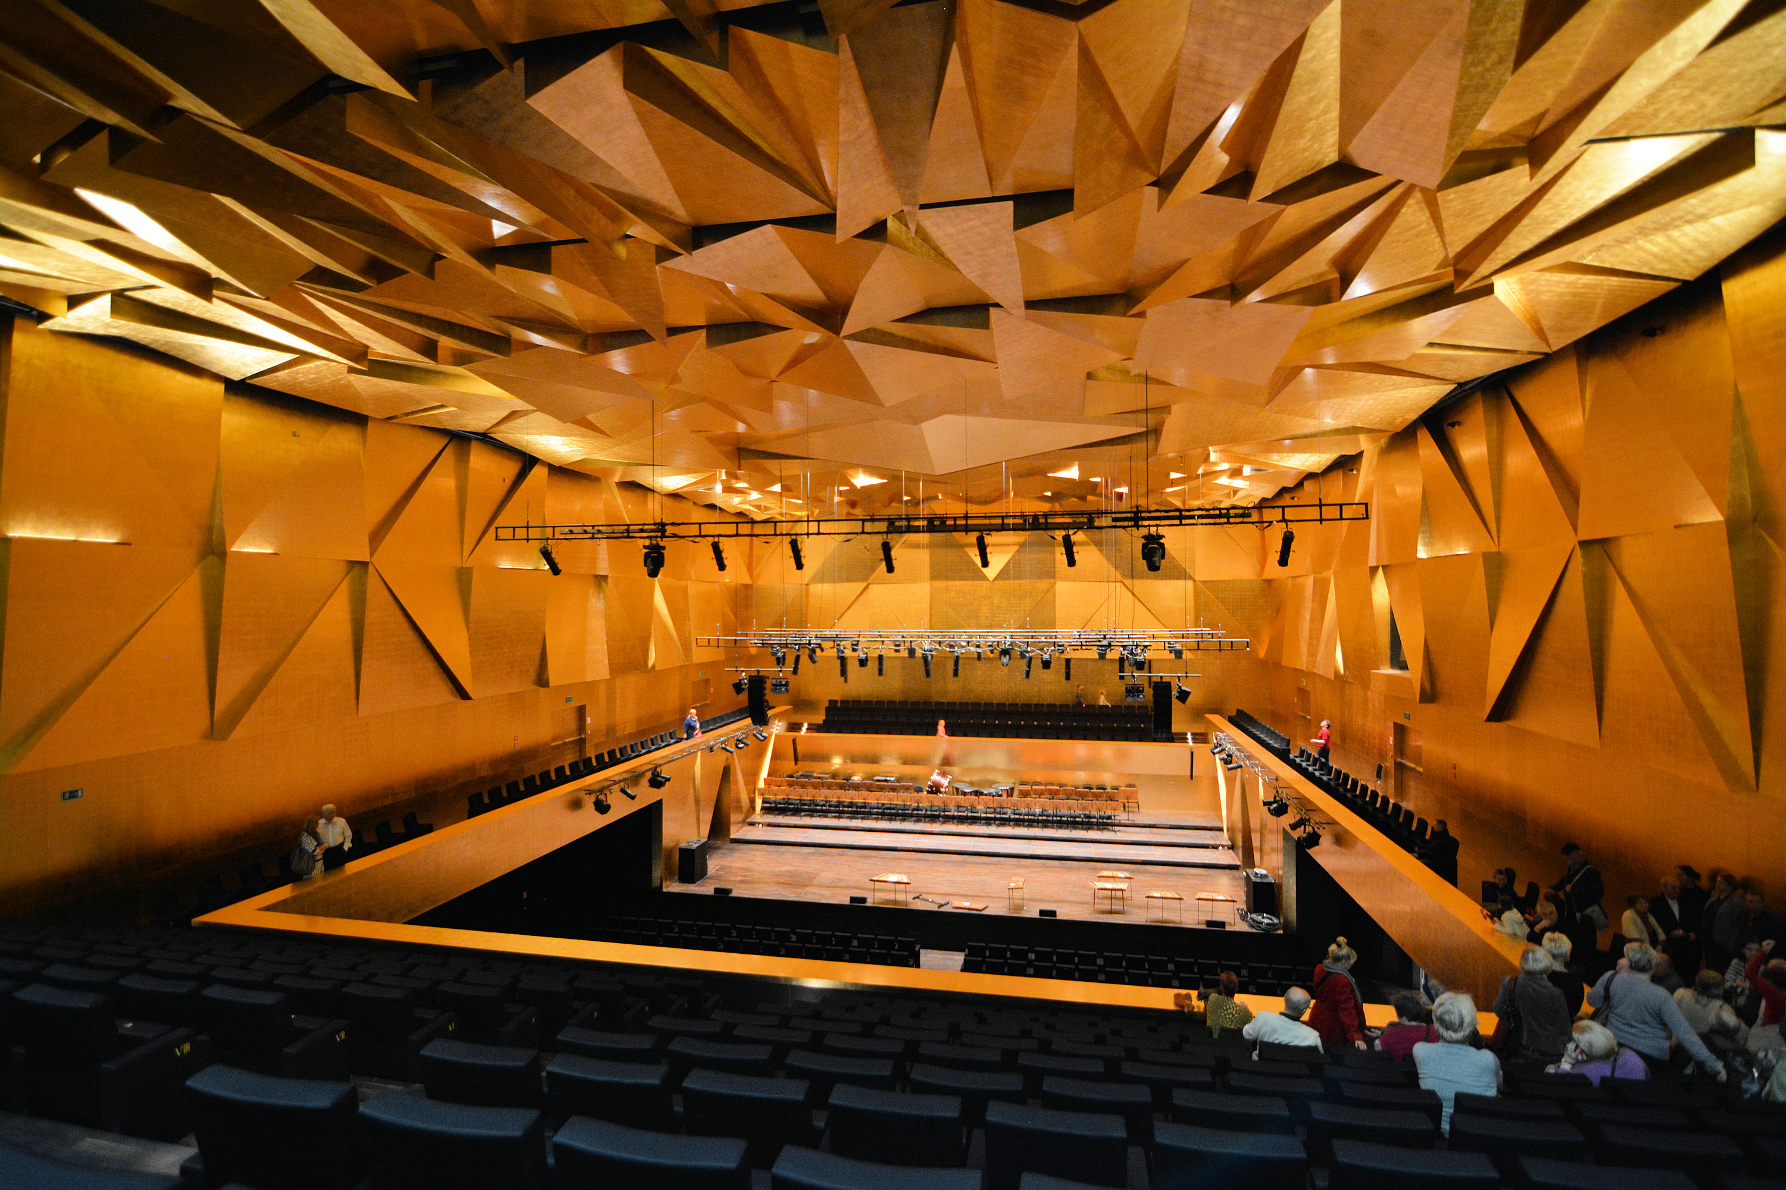
Acoustics
The study of how sounds interact with each other in the environment.
Why does music sound so good in a concert hall?

Slide 25
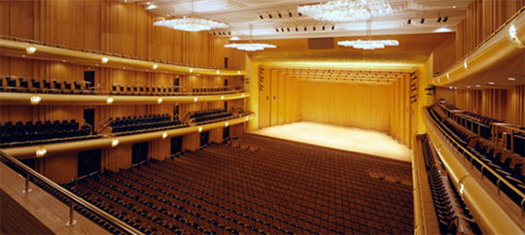
Acoustics
The acoustics in a concert hall are designed to reduce or eliminate interference.
They are also designed to reduce reverberation: echoes of a sound that are heard after the source stops producing sound.

Slide 26
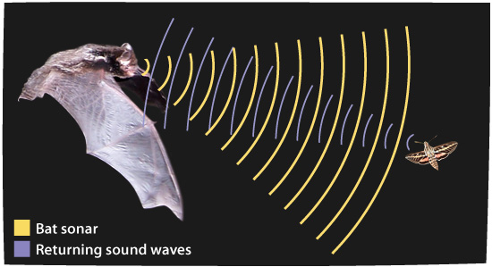
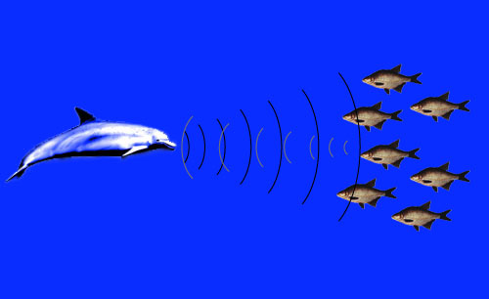
Using Sound
Bats, dolphins and whales use echolocation to navigate and to find food.
Echolocation: the use of reflected sound waves to determine distances or locate objects.
Bats: 100,000 Hz
Dolphins: 150,000 Hz

Slide 27
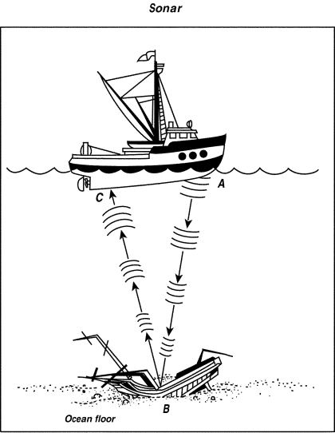
Ultrasound Technologies
Sonar: A system that uses reflected sound waves to detect objects underwater.
Distance = Speed x Time
To determine distance using sonar, divide the result by 2. Why?
How deep is the sunken ship if it takes 8 seconds for the wave to reach the surface again?

Slide 28
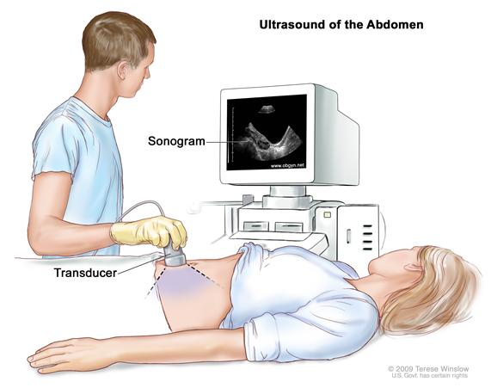
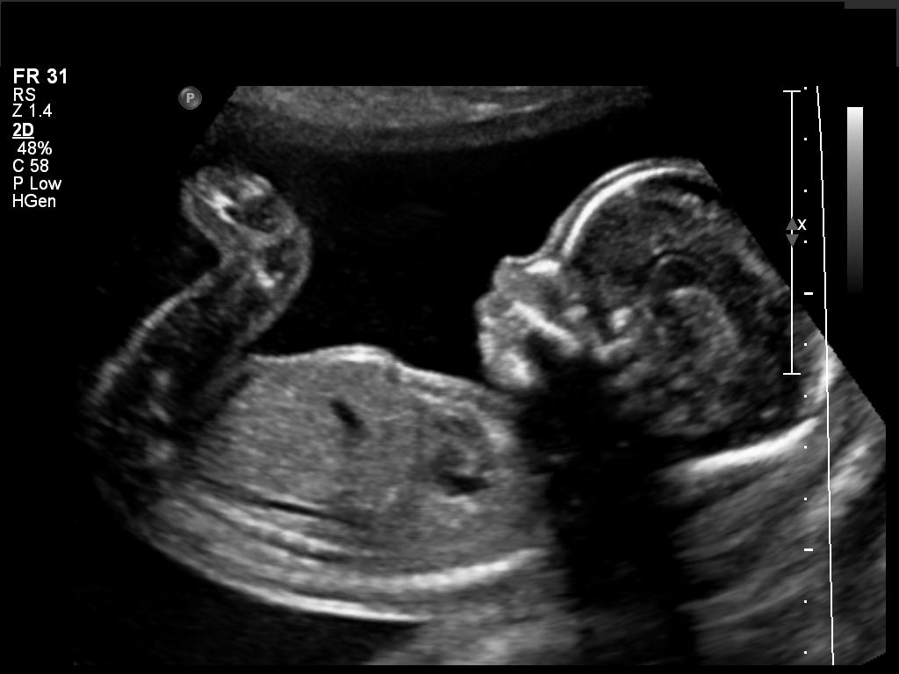
Ultrasound Technologies
Ultrasound imaging: doctors can use ultrasound to take images inside the human body.
A sonogram is an image formed using reflected ultrasound waves. (about 4 million Hz)

